Slide 1
Nanostructured Materials lecture-1
Principle and theory of Nanoscale dimension
Dr. Suha I. Al- Nassar

Slide 2
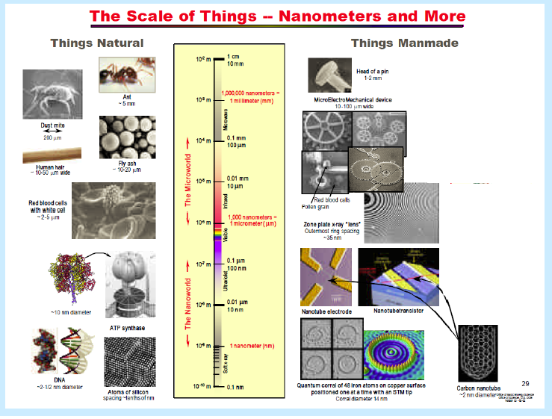
Introduction
What is Nanotechnology?
The design, characterization, and application of structures, devices, and systems by controlled manipulation of size and shape of materials at the nanometer scale (atomic, molecular, and macromolecular scale) ,
To produce materials with at least one novel/superior characteristic or property.

Slide 3
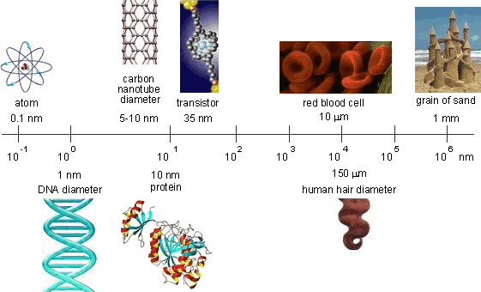
The transition from micron range particles to nanoparticles leads to a number of changes in their properties; the major change is the increase in the surface area to volume. Thus large fractions of surface atoms together with ultra-fine size and shape effects make nanoparticles exhibit distinctly different properties from the bulk

Slide 4
Various Nanomaterials and
Nanotechnologies
Based on the size and shape, the Nano materials are classified as follows
  Nanomaterials
  Nanoparticles
  Nanoscale
  Nanoscience
  Nanowires
  Nanotubes
  Nanoshells
  Nanocolloide
  Nanocluster

Slide 5
Nanomaterials are defined as a solid material characterized by at least one dimension in the nanometer range can be classified into nanocrystalline materials and nanoparticles. The former are polycrystalline bulk materials with grain sizes in the nanometer range (less than 100 nm), while the latter refers to ultrafine dispersive particles with diameters below 100 nm.
The term Nanoparticle (NPs) refers to a particle where all the three dimensions are in the nanometer scale and it exists in different shapes such as spherical, triangular, cubical, pentagonal, rod-shaped, shells, ellipsoidal and so forth. It contains small enough number of constituent atoms or molecules that they differ from the properties inherent in their bulk counterparts . (NPs) are generally considered as the building blocks of bulk nanocrystalline materials.

Slide 6
The term Nanoscale A scale used to measure and calculate the dimensions of the wind between 0.1 and 100 nm
The term Nanoscience A science that deals with the material at its atomic and molecular level with a scale not exceeding 100 nm, A science that is also interested in discovering and studying the properties of nanomaterials.
The term Nanowires a nanowire in nanoscale dimensions having a single dimension and characterized by characteristics Electric and photovoltaic are considered to be the basic building blocks used in the building of nano devices.
The term Nanoscale A scale used to measure and calculate the dimensions of the wind between 0.1 and 100 nm.

Slide 7
The term Nanotubes such as carbon nanotubes, are cylindrical tubes Carbon is one- dimensional, hexagonal or pentagonal and has physical properties Featured.
The term Nanoshells The particles in the nanoparticles have a peel or can be said to be a thin metal layer surrounding the roll , Made of semiconductor material have the ability to absorb or diffuse light in all its lengths Waveform.
The term Nanocolloid is a stable liquid phase containing particles in different sizes ranging from nanometers to several hundreds of micrometers, many colloidal particles can be detected by the way of the scatter light, such as dust particles in air.
The term Nanocluster usually refers to small nanoparticles that have well-defined composition and surface structure as finite aggregates of atoms or molecules which are bound by forces of metallic, covalent, ionic or Vander Waals bonds.

Slide 8
Principle and theory of Nanomaterials
The principle | Property
Ability to control the movement of atoms individually accurately and rearrange them. | The possibility of building any material in the universe because the atom is the construction unit for all materials.
The physical and chemical properties of the material at the nanometer scale differ from those of the same material at its natural scale. | The discovery of characteristic properties of the materials used in many inventions and applied fields.
Nanotechnology is based on the principles of physics, chemistry, biology and electronic engineering. | Linking science and encouraging everyone in different scientific disciplines to enter into its field and cooperate with each other.
The ability to control atoms in the manufacture of materials and machines and purifying them from impurities and removing them from defects. | The properties of materials and machines become better. They are smaller, lighter, stronger, faster, cheaper and less energy intensive.
Nanotechnology is based on scientific research that can be applied to useful inventions and uses. | Science fiction has become a reality

Slide 9
Principle and theory of Nanomaterials
Nanomaterials display unique, superior and indispensable properties and have attracted much attention for their distinct characteristics that are unavailable in conventional macroscopic materials, for example:
Nanomaterials may have a significantly lower melting point or phase transition temperature and appreciably reduced lattice constants, due to a huge fraction of surface atoms in the total amount of atoms also the crystal structures are stable at high temperatures, but in nanometer sizes they are stable at lower temperatures, so ferroelectrics and ferromagnetic may lose their ferroelectricity and ferromagnetism when the materials are shrunk to the nanometer scale.

Slide 10
In addition the optical properties of nanomaterials can be significantly different from bulk crystals. For example, the optical absorption peak of a semiconductor nanoparticle shifts to a short wavelength, due to an increased band gap. Therefore the bulk semiconductors become insulators when the characteristic dimension is sufficiently small.
Also the structure that occur when bulk material are reduced in dimensions generally that bulk materials exhibit continuous absorption and electronic spectra, but when the particle size decreases less than either the exaction Bohr radius or deBroglie wavelength of bulk materials used, the valance and condition bands break into quantized energy level and electronic transition becomes discrete this leads to an increase in the band gap energy i.e. the quantum confinement leads to a collapse of the continuous energy bands of a bulk material into the discrete structure of energy states .

Slide 11
The properties of bulk materials can be different at the Nanoscale for two main reasons:
First, Quantum effects can begin to dominate the behaviour of matter at the Nanoscale.
Second, Nanomaterials have a relatively larger surface area when compared to the same mass of material produced in a larger form. Nano particles can make materials more chemically reactive and affect their strength or electrical properties.

Slide 12
The significance nanoscale quantum confinement of the electron provides visualization of the shift in the characteristics of the material depending on the size of the nanoparticles, for example in the case of metals, typical “metallic” properties, the electronic conduction band of a metal gradually evolves from continuous levels of a bulk infinite material into discrete states as a function of size reduction, resulting in an increase in the band gap energy as shown in Figure 1.1 a. Also in semiconductor material, the band gap increases with decreasing particle size, and the excited electronic states become discrete with high oscillator strength as illustrated in Figure 1.1b .

Slide 13
The significance nanoscale quantum confinement of the electron provides visualization of the shift in the characteristics of the material depending on the size of the nanoparticles, for example in the case of metals, typical “metallic” properties, the electronic conduction band of a metal gradually evolves from continuous levels of a bulk infinite material into discrete states as a function of size reduction, resulting in an increase in the band gap energy as shown in Figure 1.1 a. Also in semiconductor material, the band gap increases with decreasing particle size, and the excited electronic states become discrete with high oscillator strength as illustrated in Figure 1.1b .

Slide 14
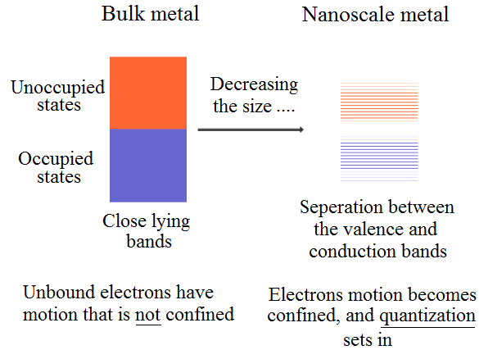
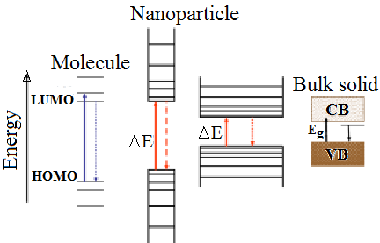
(a)
(b)
Figure 1.1: Energy diagrams of bulk and nanomaterials in:
a- metallic materials b- semiconductor material

Slide 15
The second feature distinctive of nanomaterials is very high surface to volume ratios. High surface areas can be attained either by fabricating small particles or clusters where the surface-to-volume ratio of each particle is high, or by creating materials where the void surface area (pores) is high compared to the amount of bulk support material. Because most of energies are surface atoms; therefore the atoms in nanostructures have a higher average energy than atoms in larger structures. Therefore, in this scale the surface atoms become dominant at the lower end of the size limit. As can be seen from Figure 1.2, the surface atoms became dominant only when the palladium particle size reduced to below 10 nm.

Slide 16
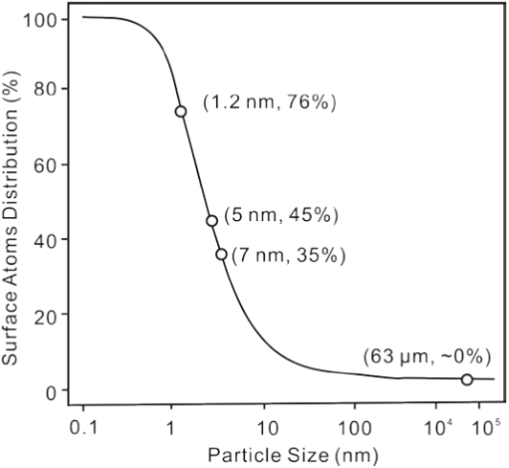
Figure 1.2: The percentage of surface
atoms changing with the palladium
cluster diameter [39].

Slide 17
For example the specific surface area (S) of sphere nanoparticles with diameter (r) is given by the following equation :
S = (A)/ (ρ V) = 6*10³/ ρ r_{NPs} ……………………. (1.1)
Where
A: is the area (cm ²),
V: is the volume (cm³)
ρ : is the density (g/cm³) and
r_{NPs}: is the size of nanoparticles (cm)
The specific surface area not depends on the size of NPs only but it depends on the shape of nanoparticles as shown in Figure 1.3. Therefore the efficient way to increase the surface area of material is to decrease its particle size or shape .

Slide 18
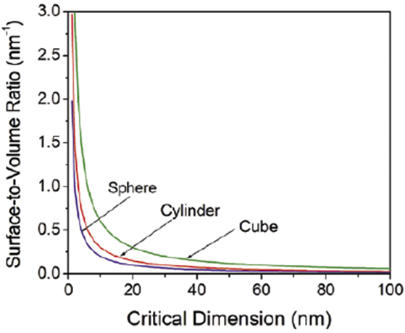
Figure 1.3: Surface to volume ratio for sphere, cube and cylinder as a function of critical dimensions nanoscale materials have extremely high surface to volume ratios as compared to large –scale material .

